Slide 1

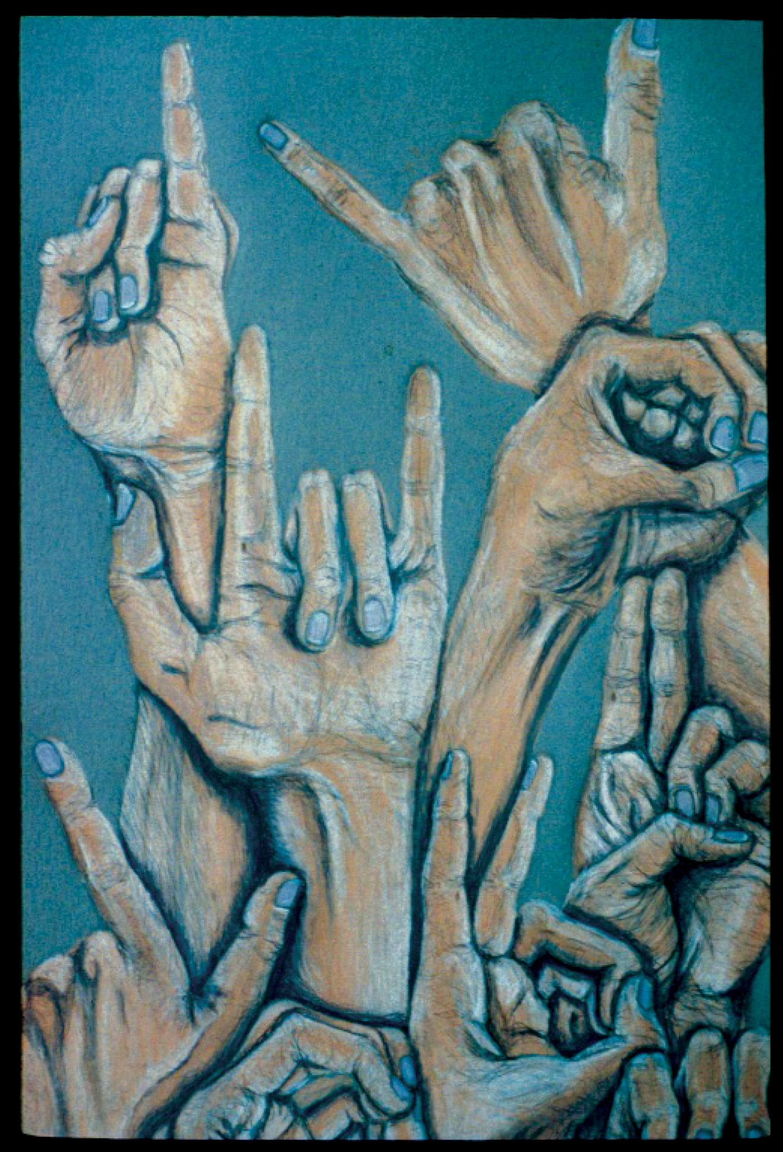
PROJECT WORK - II
Project TiTle: Comparison of CNN and Contour algorithms for deaf language identification using hand gestures recognition
Group Members:
ADARSH PATHAK (EN17CS301017)
FARAZ AHMED KHAN (EN17EL301049)
PROJECT GUIDE : Mr. Chandrashekhar Kothari

Slide 2
INTRODUCTION
Some of the major problems faced by a person who are unable to speak is they cannot express their emotion as freely in this world.
They are not able to utilize (Artificial Intelligence/personal Butler) like google assistance, or Apple's SIRI etc.
One of the solutions to talk with the deaf-mute people is by using the mechanisms of sign language.
Hand gesture is one of the methods used in sign language for non-verbal communication.
Given a hand gesture, implementing such an application which detects predefined American sign language (ASL) in a real time through hand gestures and display it on screen.

Slide 3
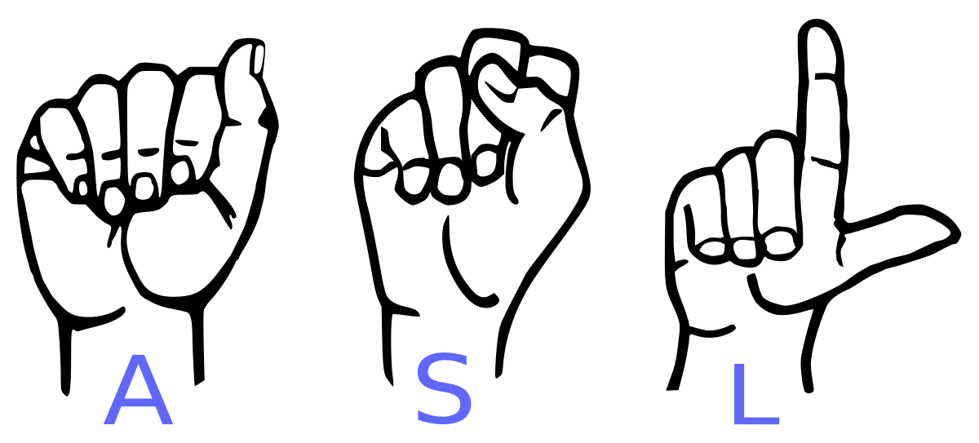
AMERICAN SIGN LANGUAGE

Slide 4
PROBLEM STATEMENT
There are many applications where hand gesture can be used for interaction with systems like, videogames, controlling UAV’s, medical equipment’s, etc. These hand gestures can also be used by handicapped people to interact with the systems. Classical interactions tools like keyboard, mouse, touchscreen, etc. may limit the way we use the system. All these systems require physical contact, in order to interact with system. Gestures can interpret same functionality without physically interacting with the interfacing devices.
The problem lies in understanding these gestures, as for different people, the same gesture may look different for performing the same task. This problem may be overthrown by the use of Deep Learning approaches and Contour approaches.

Slide 5
FEATURES OF THIS APPLICATION
User-friendly based GUI built using industrial standard Tkinter.
Comparing real time number detection based on gesture made by user by Contour and CNN algorithms.
Real time American standard character detection based on gesture made by user.
Real time commonly used words detection based on gesture made by user.

Slide 6
TECHNOLOGIES USED
Python
Pandas and Numpy
Tkinter
Keras
OpenCV
Contour

Slide 7
KEY TASKS
CNN
Contour
Creation of python module to collect data
Collecting the data using collect module
Creation of CNN model using keras
Training The CNN model with collected dataset.
Creation of prediction module
Testing the prediction of model at realtime.
Creation of user friendly UI using Tkinter.
Integration of UI with the python modules.
Importing contour using OpenCV.
Creation of ROI.
Taking runtime image of hand
Creating contour and convex hull of the hand.
Finding convex defects in the hand.
Prediction using convex defects.
Creation of user friendly UI using Tkinter.
Integration of UI with the python modules.

Slide 8
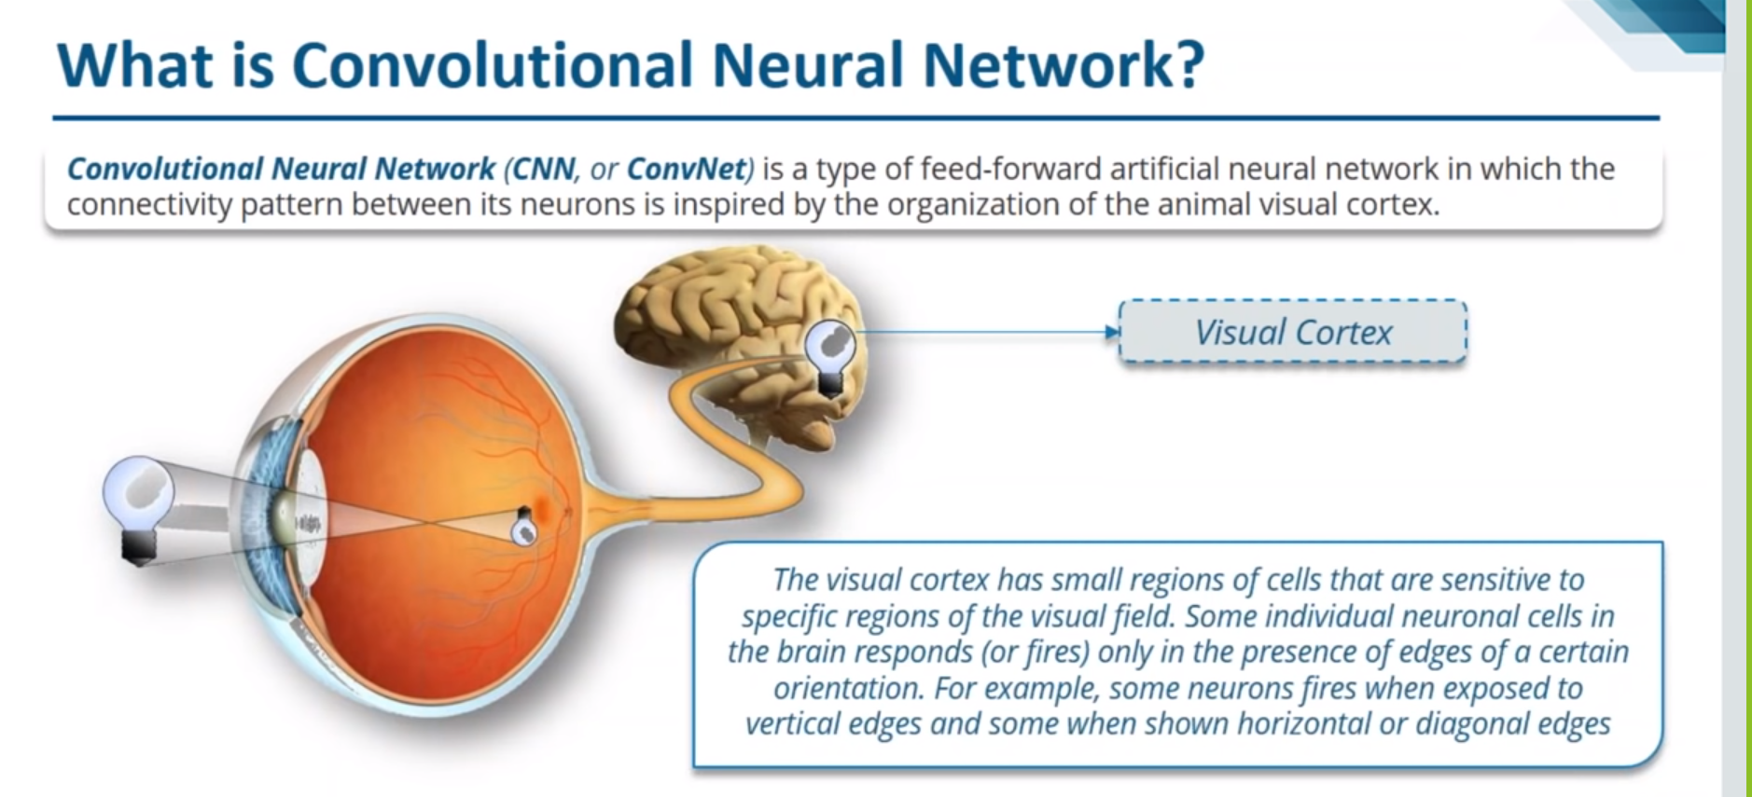

Slide 9
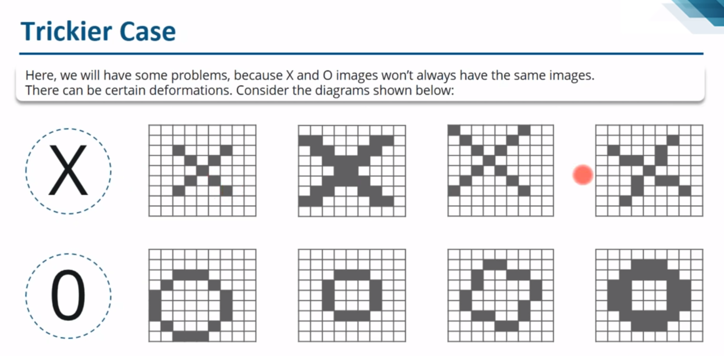

Slide 10
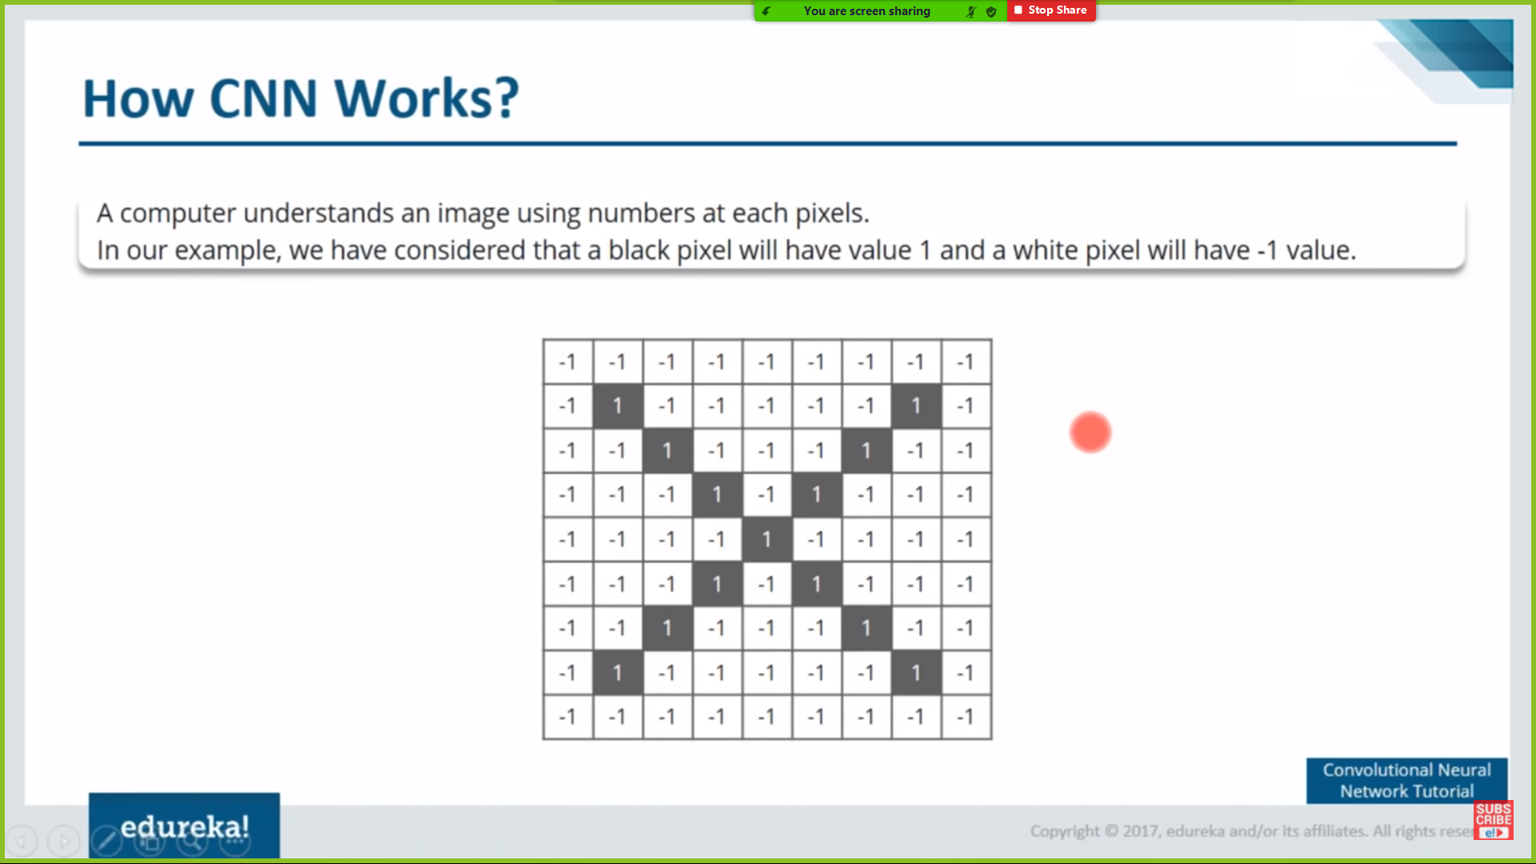

Slide 11
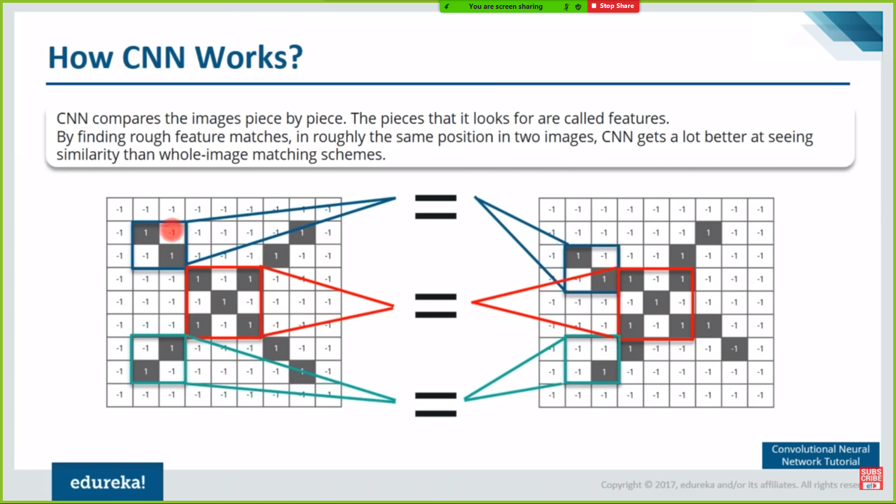
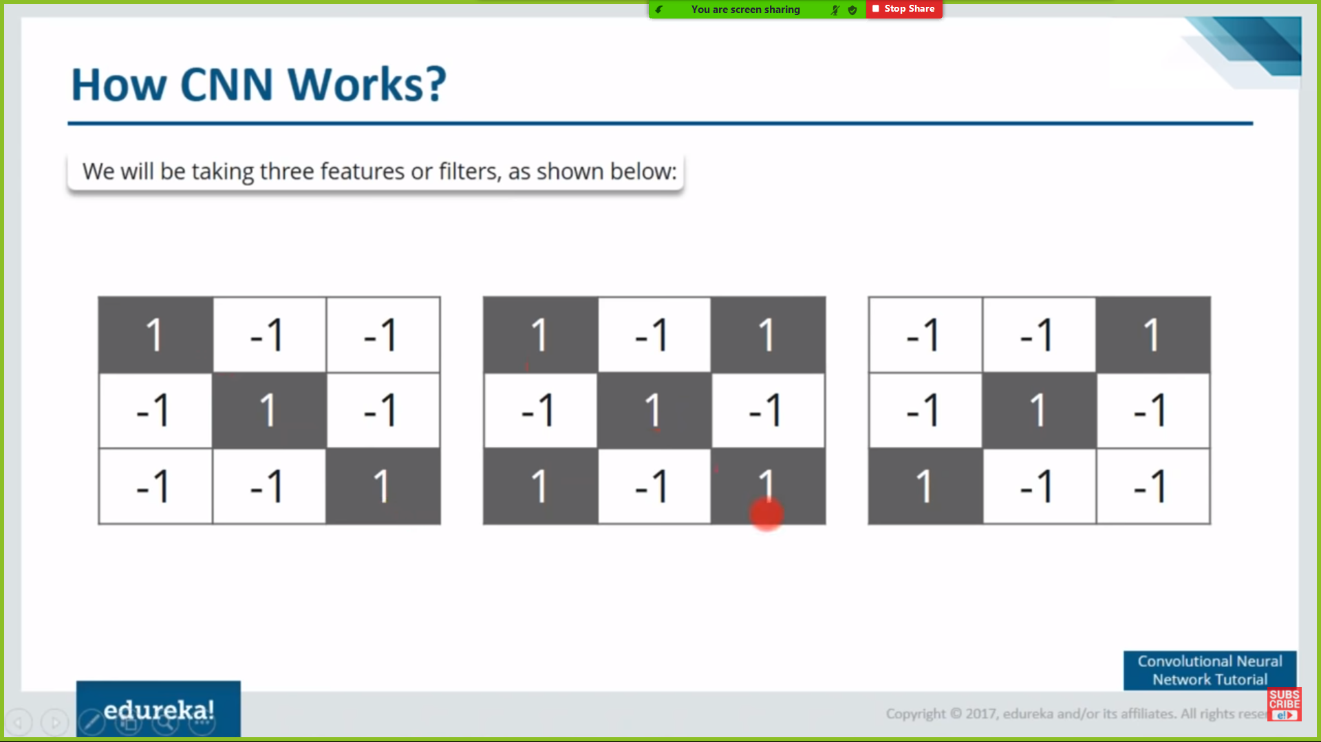

Slide 12
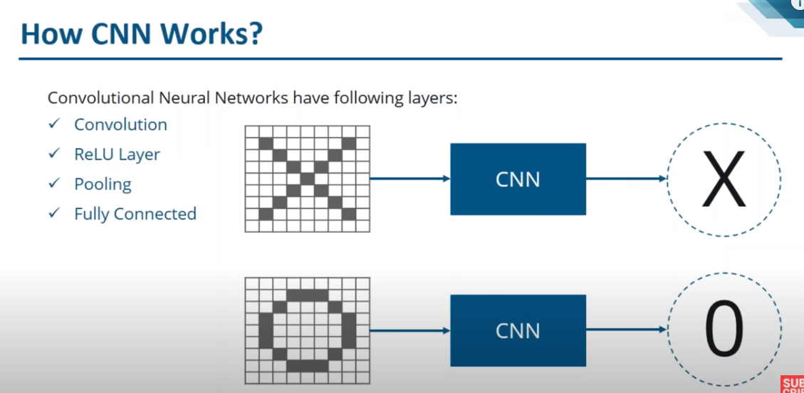

Slide 13
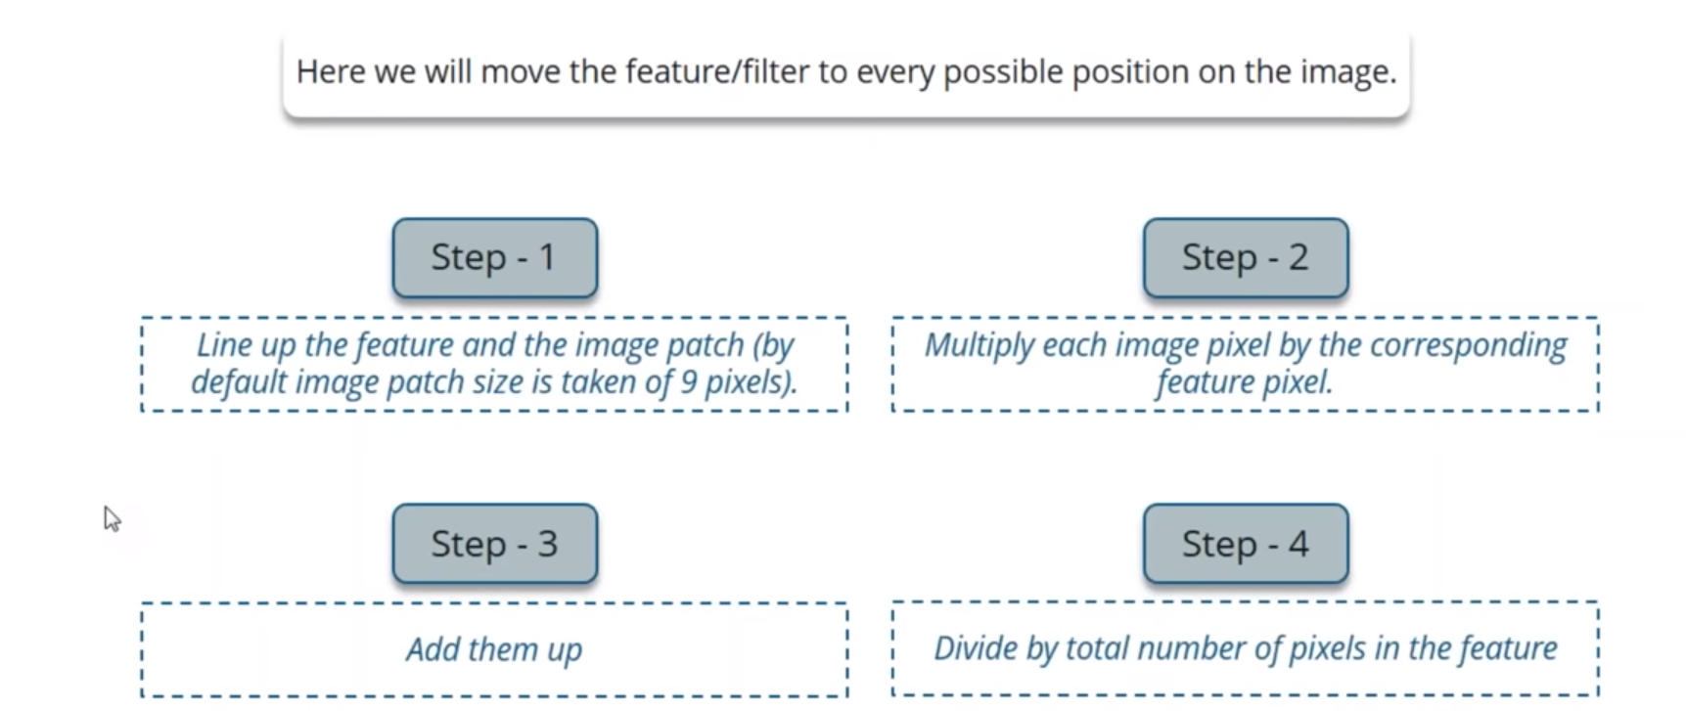
1.Convolution Layer

Slide 14
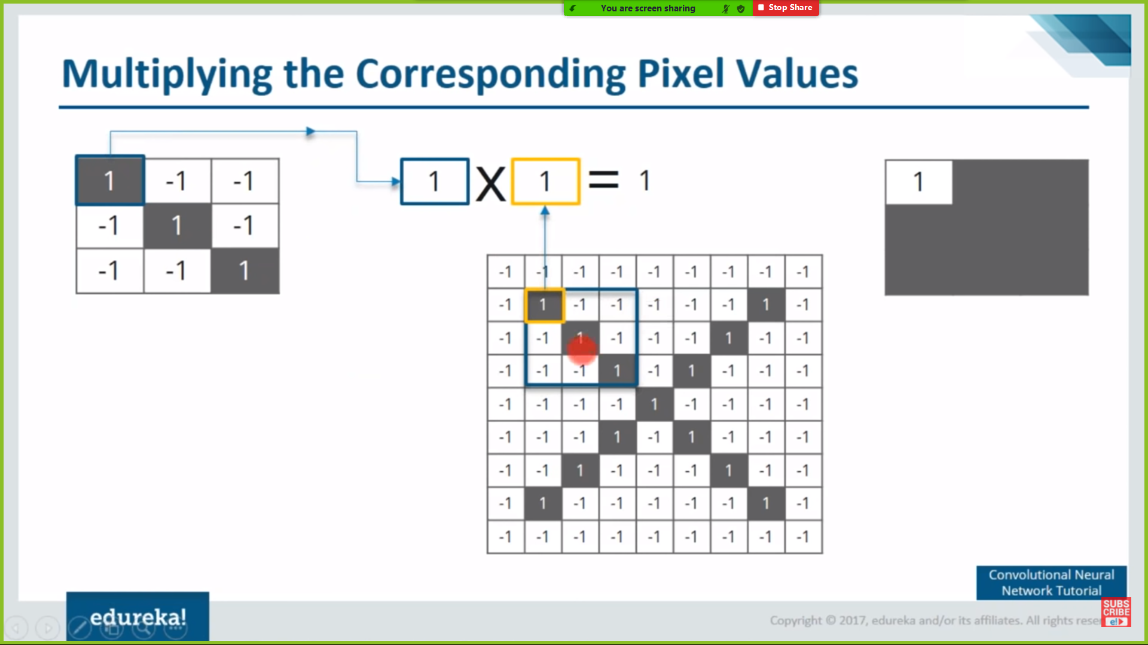
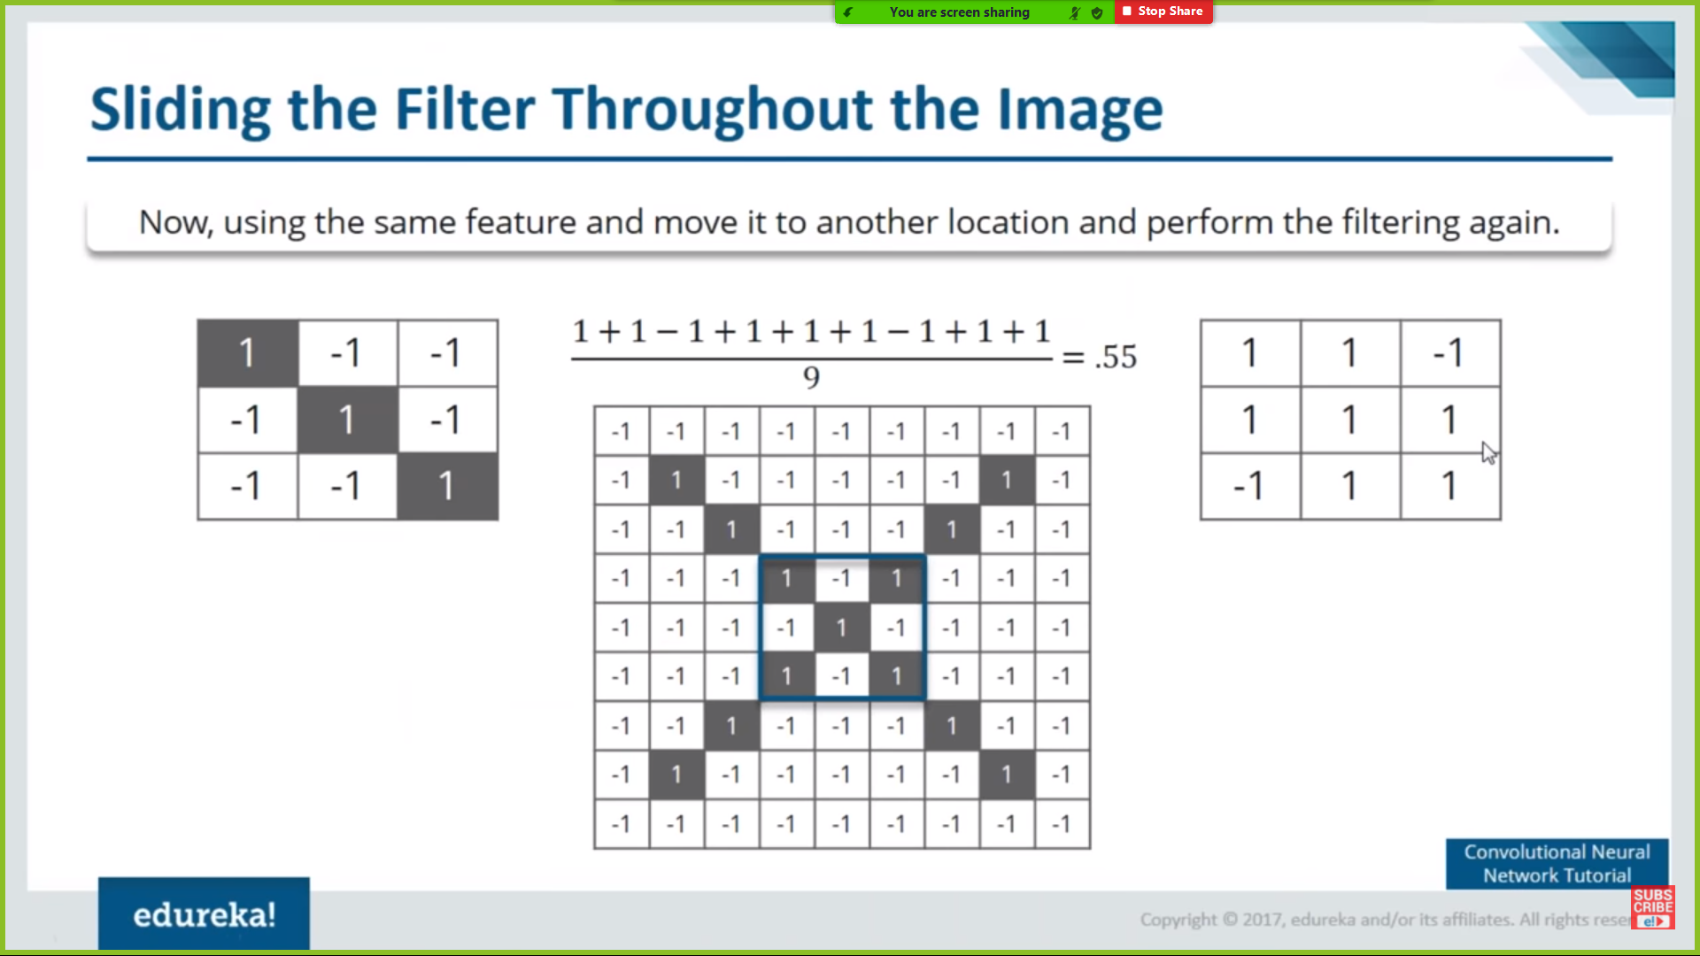

Slide 15
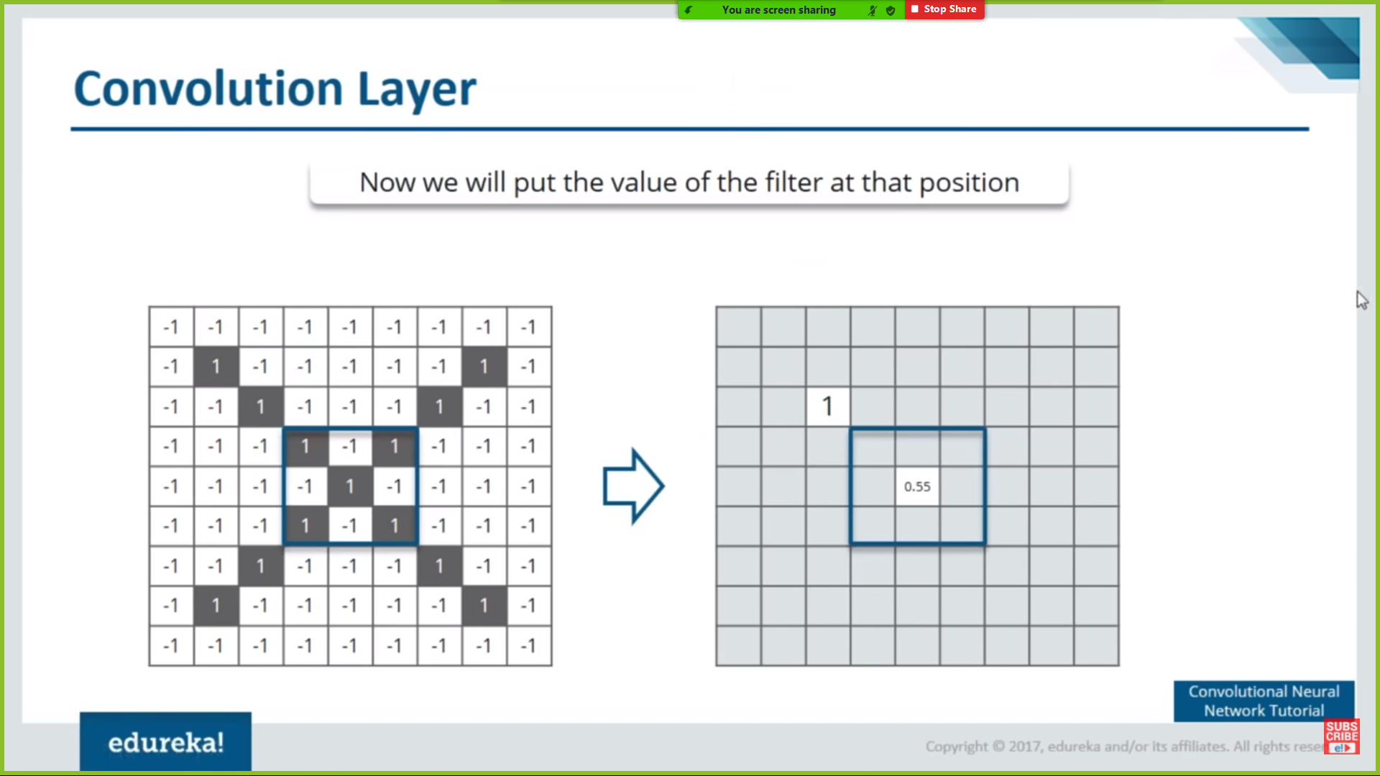
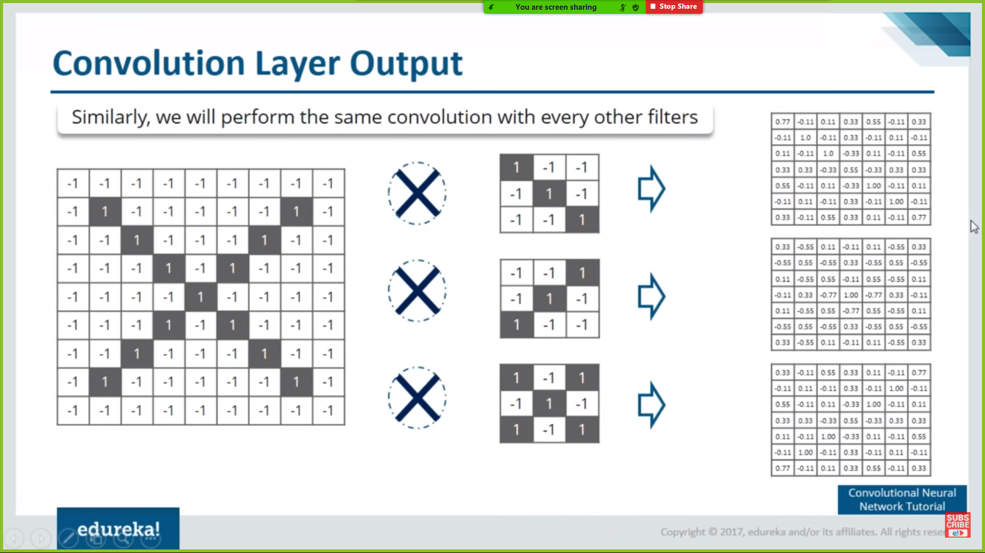

Slide 16
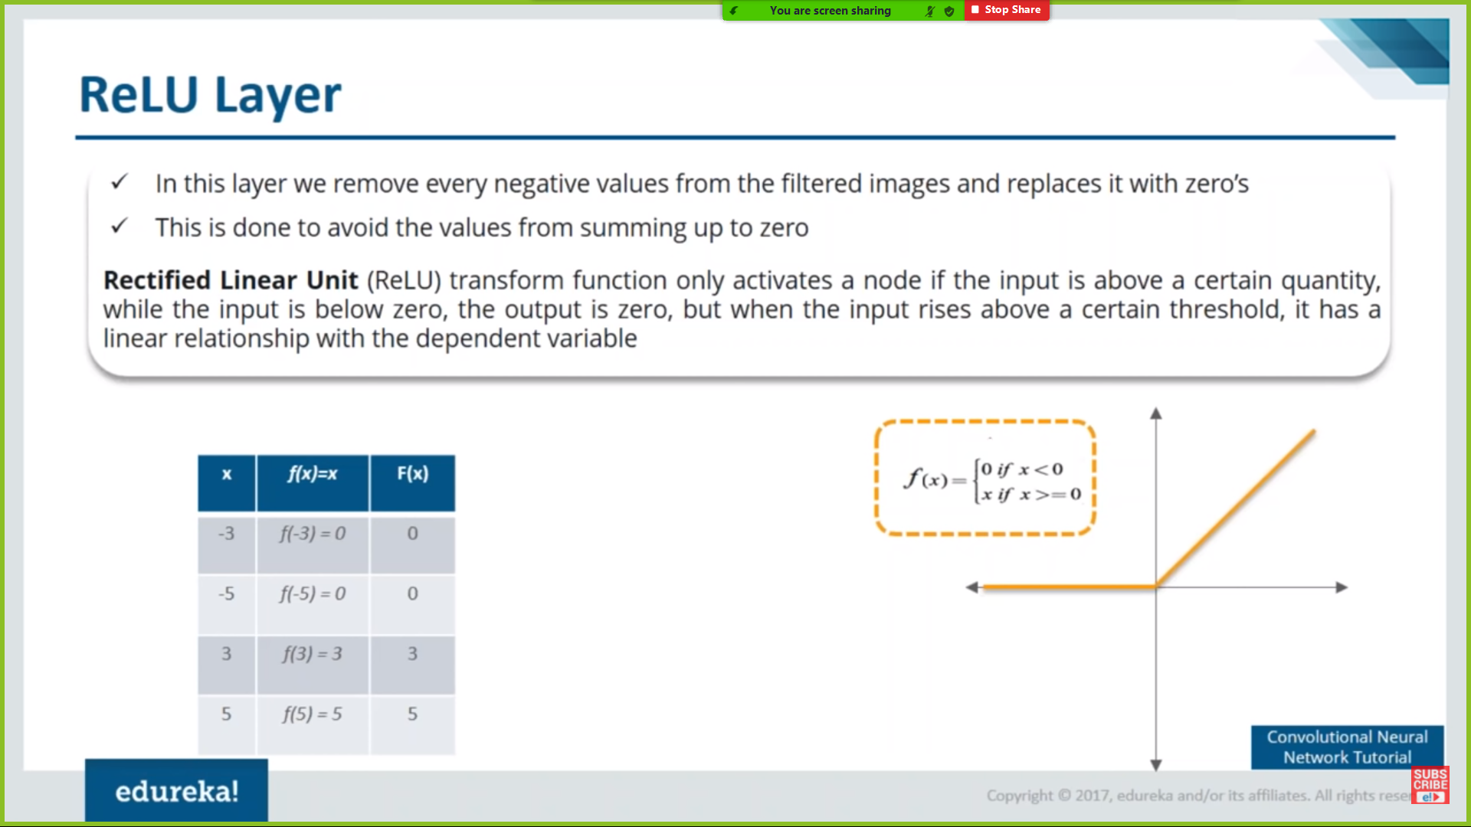
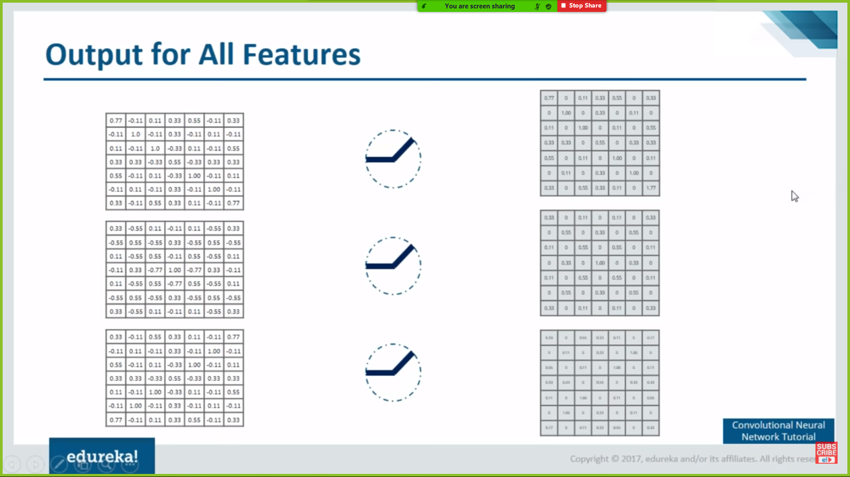
2.ReLU Layer

Slide 17
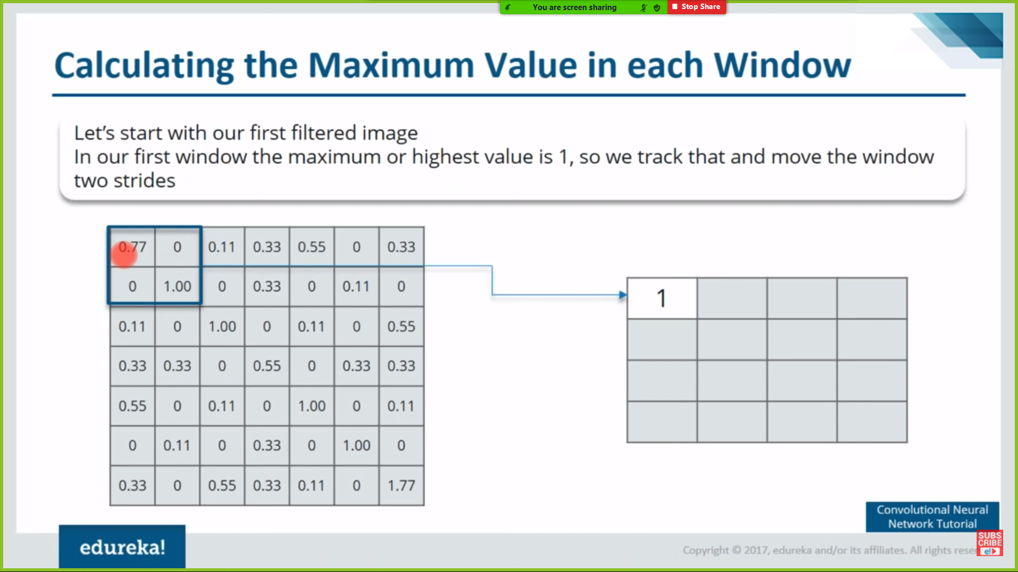
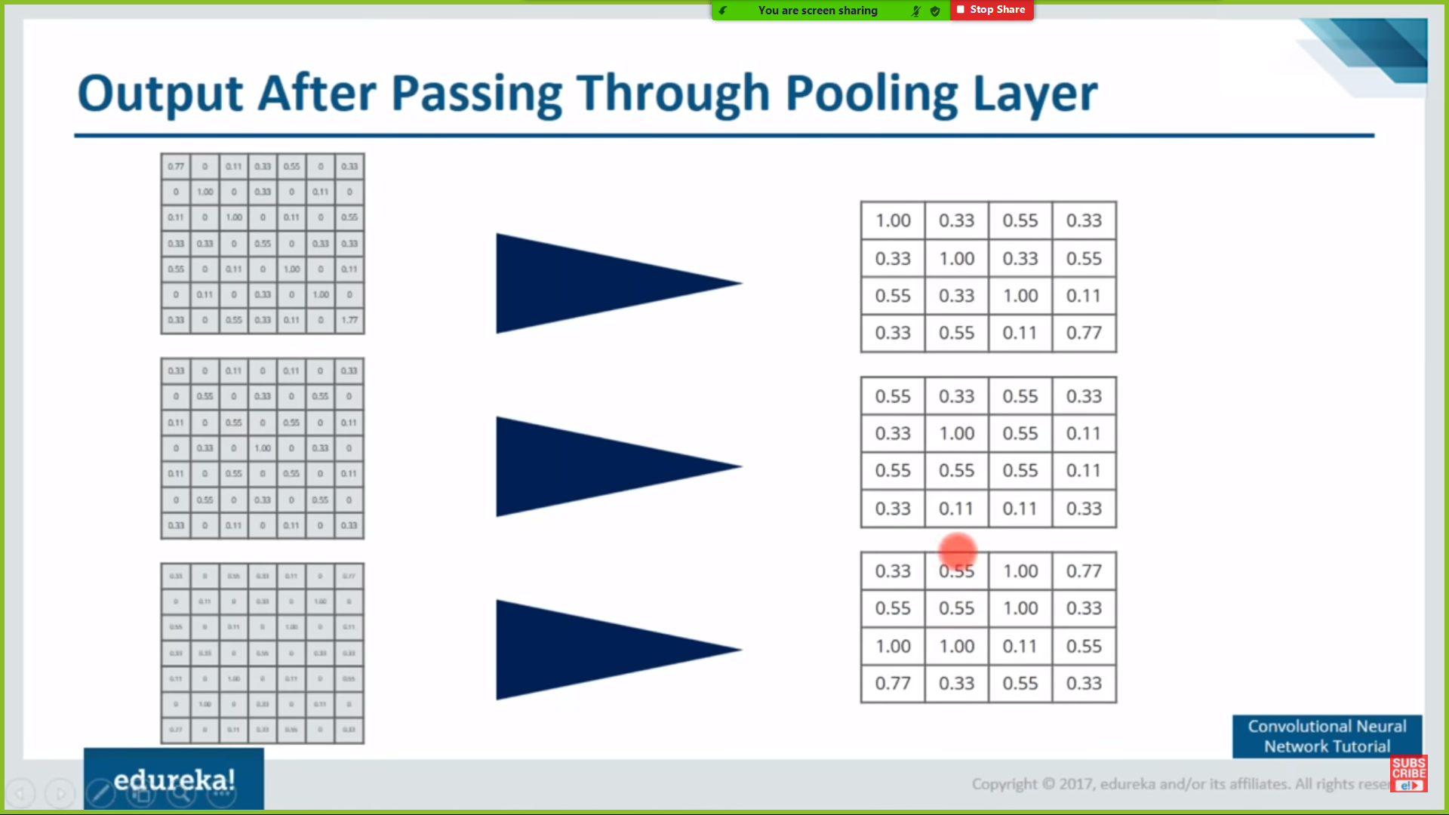
3.Pooling

Slide 18
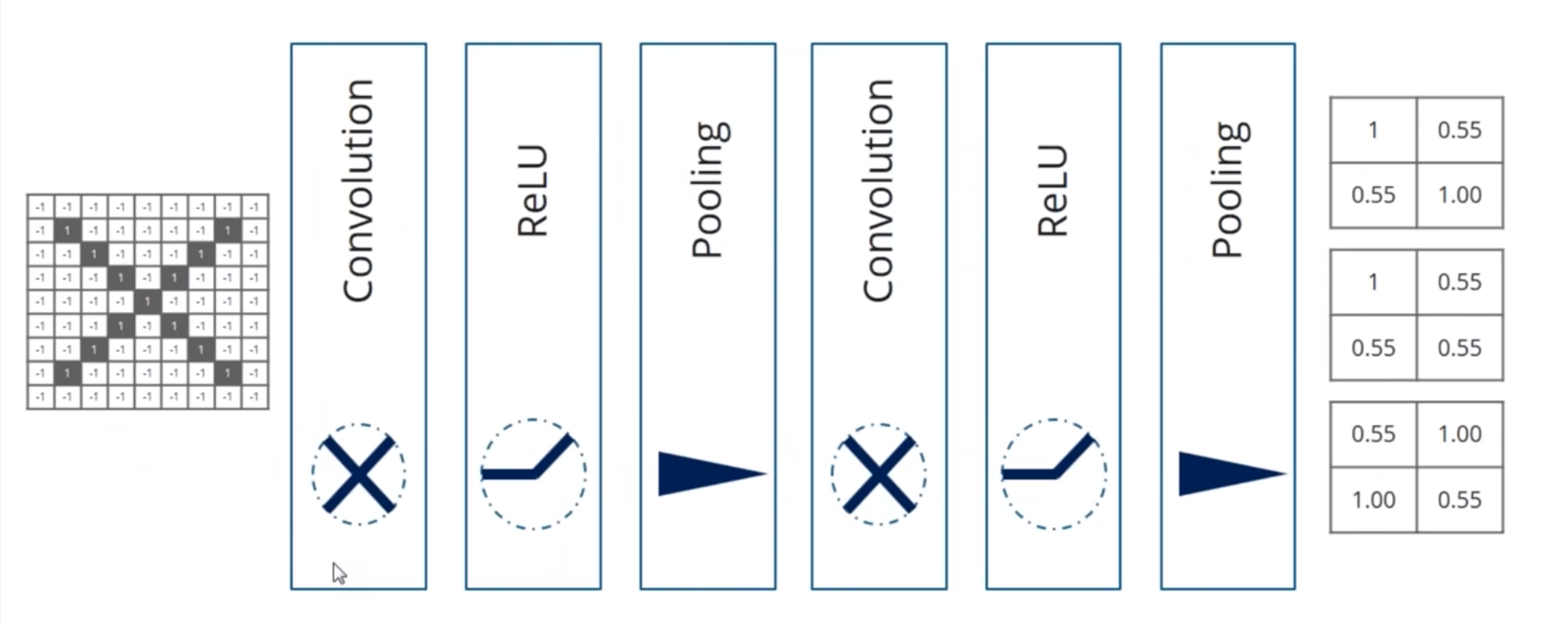
Stacking

Slide 19
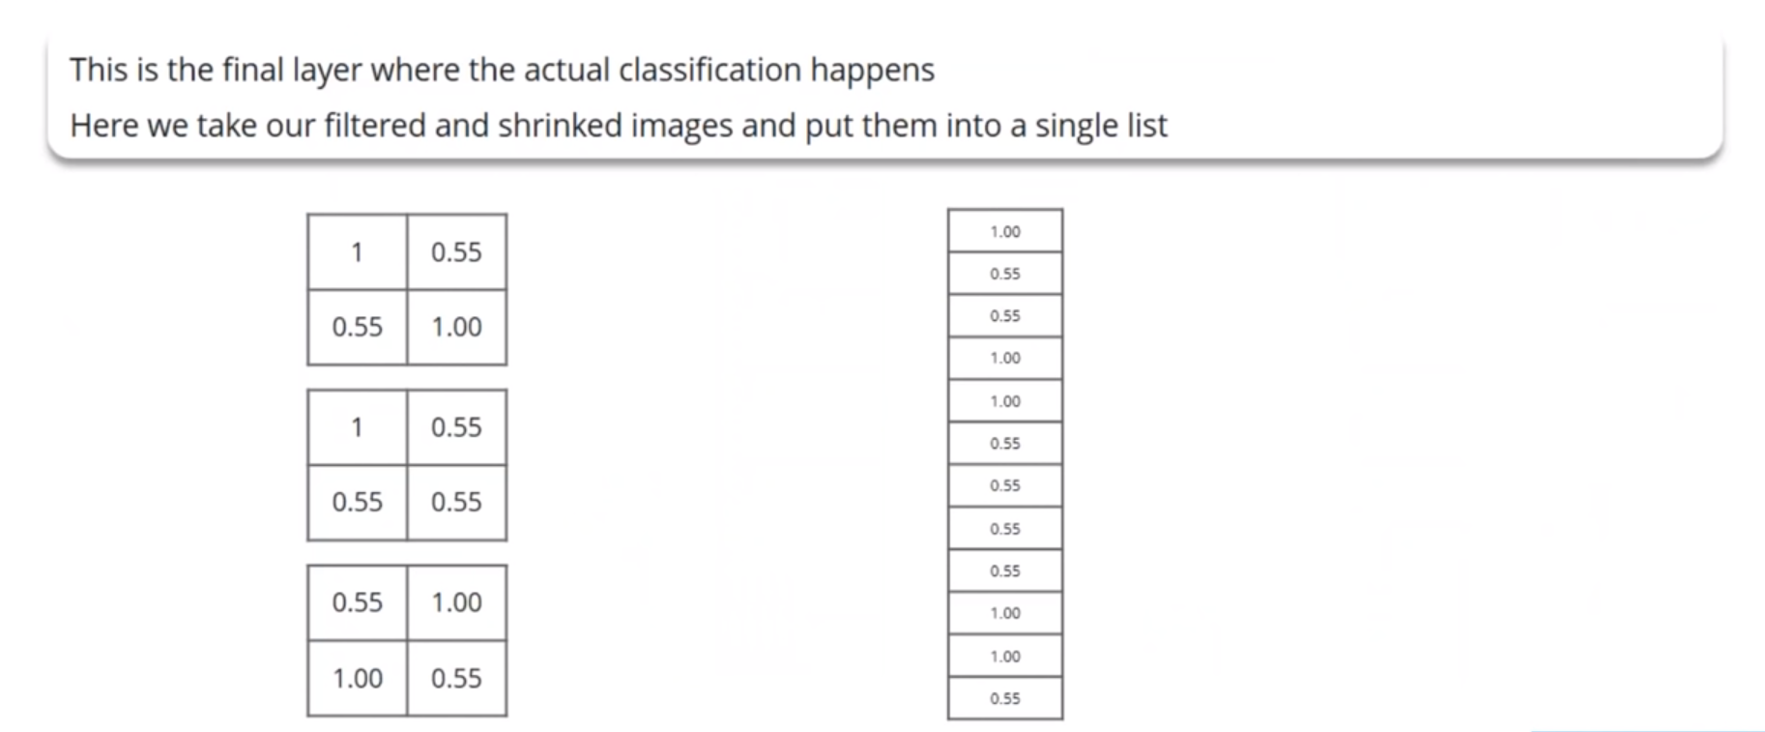
4.Fully Connected Layer

Slide 20
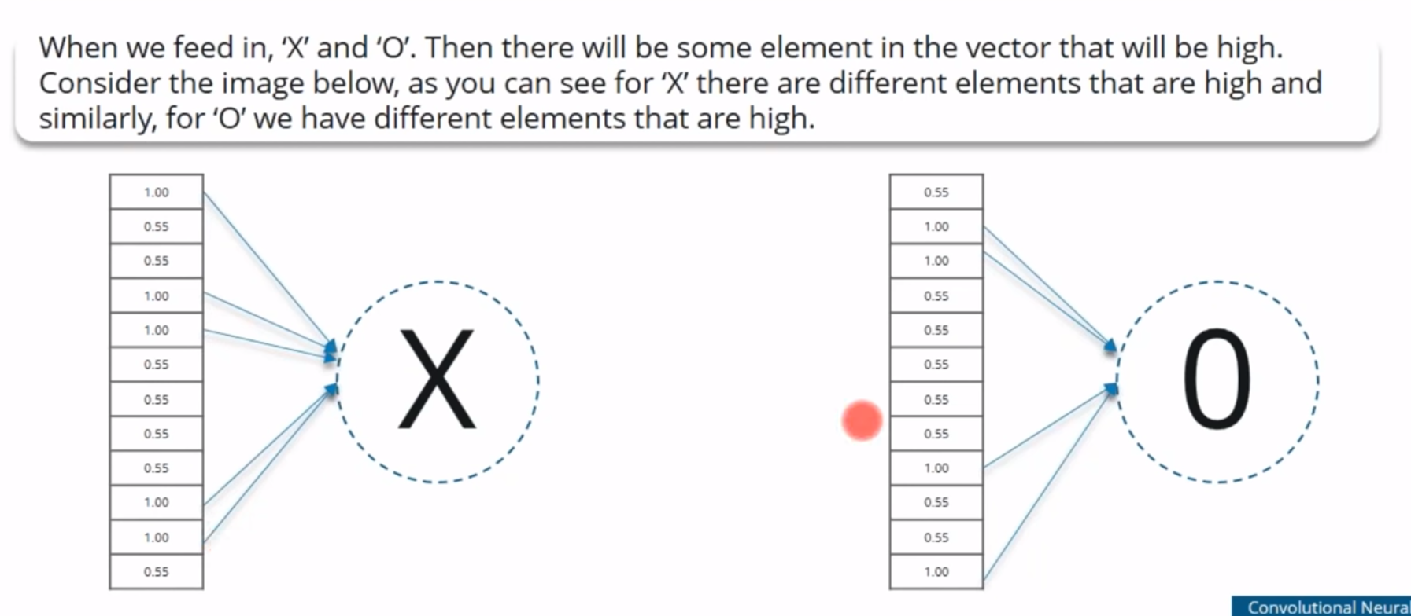
Prediction

Slide 21
Contour
The contour of hand is a series of points which are the boundary pixels of the hand area. After obtaining the contour, the gesture and its shape then can be detected and recognized by using contours analysis. Contour is constituted by the connection of edges, common edge recognition algorithms contain Sobel, Canny, Prewitt, Roberts, and Fuzzy logic methods.

Slide 22
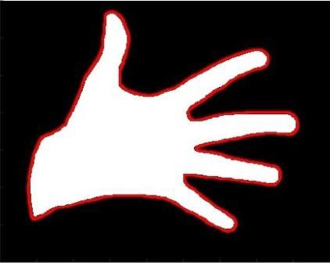
Detected contour of hand gesture

Slide 23
Convex Hull
The convex hull of hand gesture contour is the convex polygon surrounded by all the convex vertices in gesture contour, as shown in figure (a), the polygon composed by red curve is the convex hull of hand gesture in the figure, and (b) is the separated convex hull extracted from (a)

Slide 24
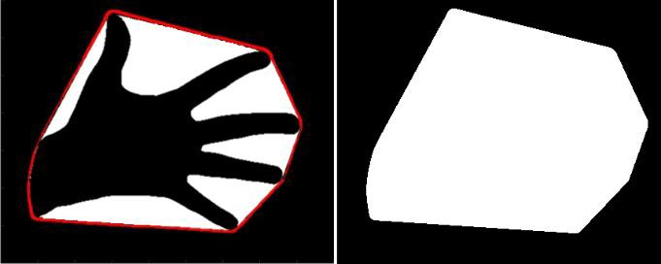
(a)
(b)

Slide 25
Convex Defect
The convex defect is defined as the difference between gesture convex hull and contour, they are contained in the convex hull but not hand area. As shown in figure , the white areas ①-⑥ are all the convex defects. The data structure of each of the convex defects contains three components: start contour point, end contour point and concave contour point. For example, for convex defect ②, P1 is its start contour point which is the starting point of the defect，P2 is its end contour point which is the termination point of the defect, and P3 is the concave point which is the furthest point away from the convex hull, and the furthest distance is the depth of convex defect.

Slide 26
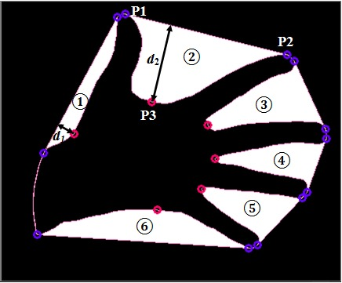
Convex defects of hand gesture

Slide 27
FEATURES EXTRACTION
For the binary image with convex defects, we can extract the convexity of gesture and relative position of fingertips as features used for hand gesture recognition. Through the observation and analysis of gesture contour and convex hull, we can get that with different gesture the tightness to its convex hull is also different, as shown in figure, the convex hull of the fist gesture in (a) almost contains the whole gesture contour, but the gesture contour in (b) has big difference with its convex hull, with several depression existing between. The tightness of hand gesture contour to its convex hull is defined as the gesture convexity, which is denoted by δ, its value is the area ratio of gesture contour and convex hull.
δ = 𝑐𝑜𝑛𝑡𝑜𝑢𝑟𝐴𝑟𝑒𝑎 / ℎ𝑢𝑙𝑙𝐴𝑟𝑒𝑎
Where, hullArea is the area of convex hull, contourArea is the area of gesture contour, we can get according to the image that hullArea > contourArea, so δ ϵ (0,1), and the bigger the value, the tighter the gesture contour to convex hull.

Slide 28
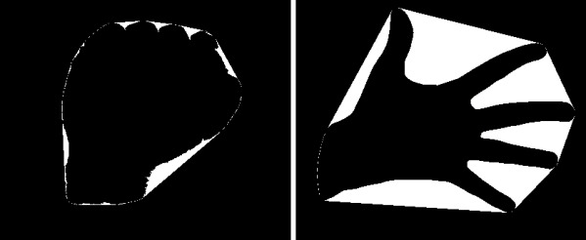
(a)
(b)

Slide 29
FUTURE SCOPE
It can be integrated with various search engines and texting application such as google, WhatsApp. So that even the deaf people could be able to chat with other persons, or query something from web just with the help of gesture.
This project is working on image currently, further development can lead to detecting the motion of video sequence and assigning it to a meaningful sentence with TTS assistance.
It can be integrated with chatbots like SIRI , google assistant.
Devices can be used without keyboard, mouse or touch.

Slide 30
